Slide 1
Xiao Bing Ye Oct. 29th, 2019
The Best Neighborhood
for the Chinese Restaurant in Toronto

Slide 2

Agenda
Introduction
Data
Methodology
Result
Discussion
Conclusion

Slide 3
Introduction
The target audiences
my friend and his team who would care about this problem - the best place for a new Chinese restaurant.
The background
My friend is looking to open a Chinese restaurant in Toronto, and he is looking for the place.
asking for my help to recommend the best place where they can open it.

Slide 4
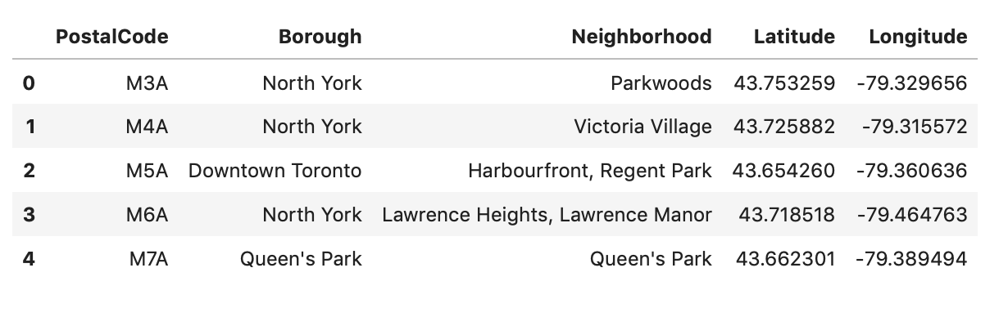
Data
Importing the dataset about postal code, borough and neighborhood in Toronto, and the latitude and longitude of each neighborhood.
There are 103 neighborhoods.

Slide 5
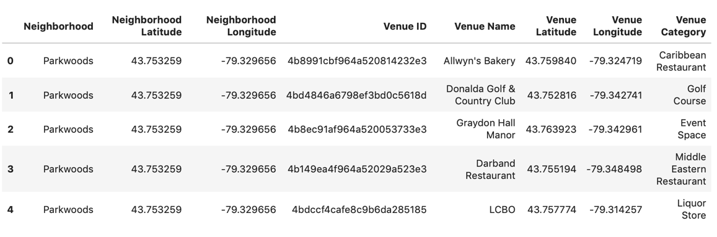
Data
getting 10167 venues in Toronto by using Foursquare data
using the Foursquare data to execute my idea.

Slide 6
Methodology
By judging if the most common venues in a neighborhood include 'Chinese Restaurant' or not, I can choose some neighborhoods which are suitable for opening the Chinese restaurant.
By using Foursquare data, I can get rating and tips of each restaurant in these neighborhoods.
By using the number, avg. rating and tips of restaurants in each neighborhood, I can decide the best neighborhood for the Chinese restaurant based on the content-based recommendation system.

Slide 7
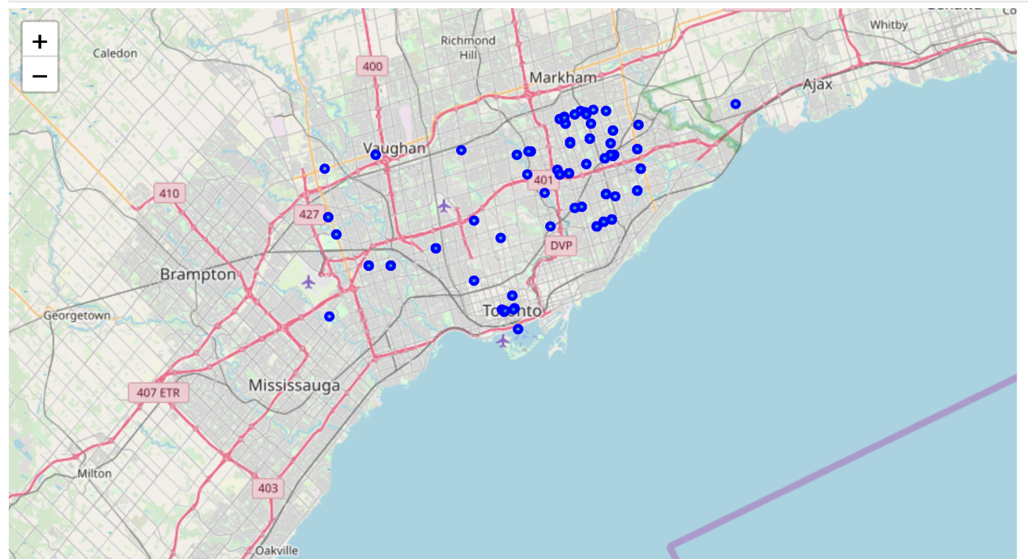
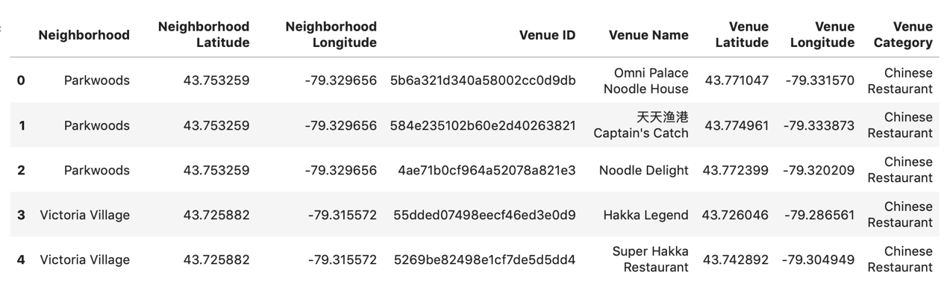
Methodology
Step 1: getting all 162 Chinese restaurant in Toronto, and showing them in the map.

Slide 8
Methodology
Step 2: analyzing each neighborhood by venue category, and getting 3 common venues of each neighborhood
If there is 'Chinese restaurant' within 3 common venues of a neighborhood, this neighborhood is suitable for my goal.
There are total 10 neighborhoods which are suitable for my goal.

Slide 9
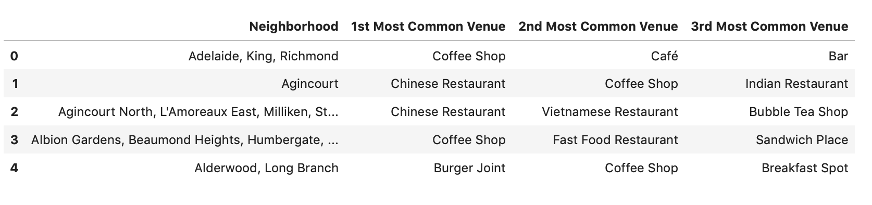
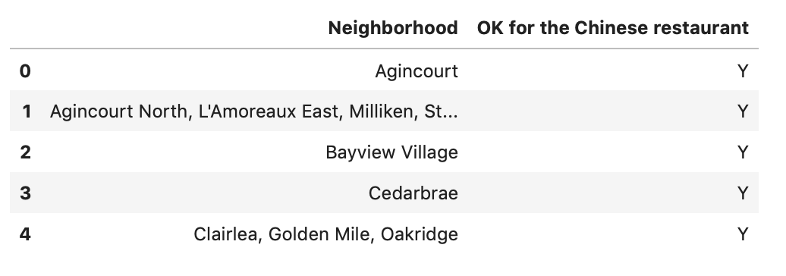
Methodology

Slide 10
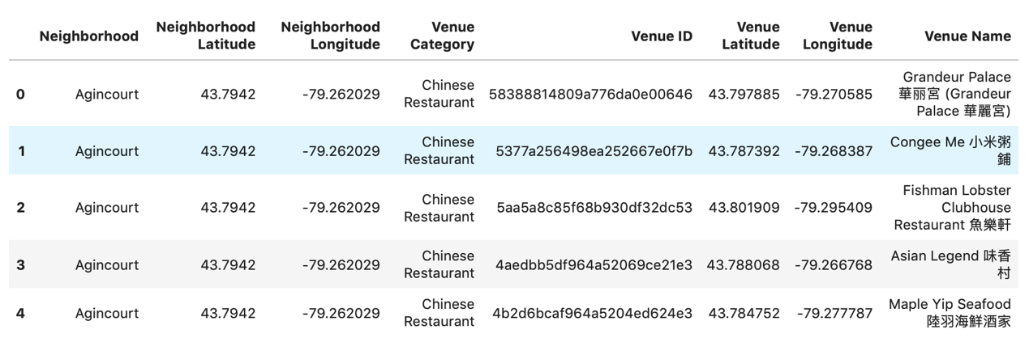
Methodology
Step 3: by analyzing Chinese restaurants of these 10 neighborhoods, deciding the best neighborhood.
There are 75 Chinese restaurants within these 10 neighborhoods.

Slide 11
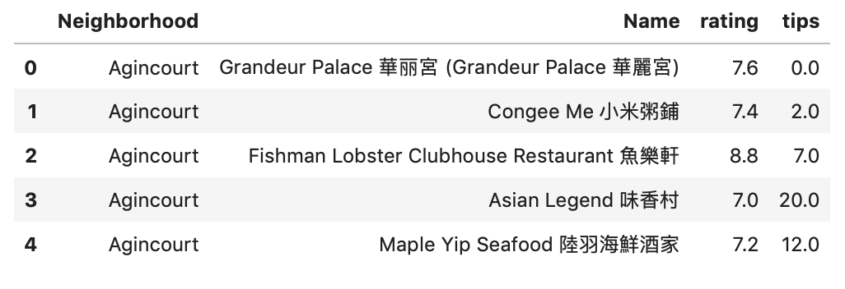
Methodology
Step 4: getting rating and tips of each Chinese restaurant by using Foursquare data.

Slide 12
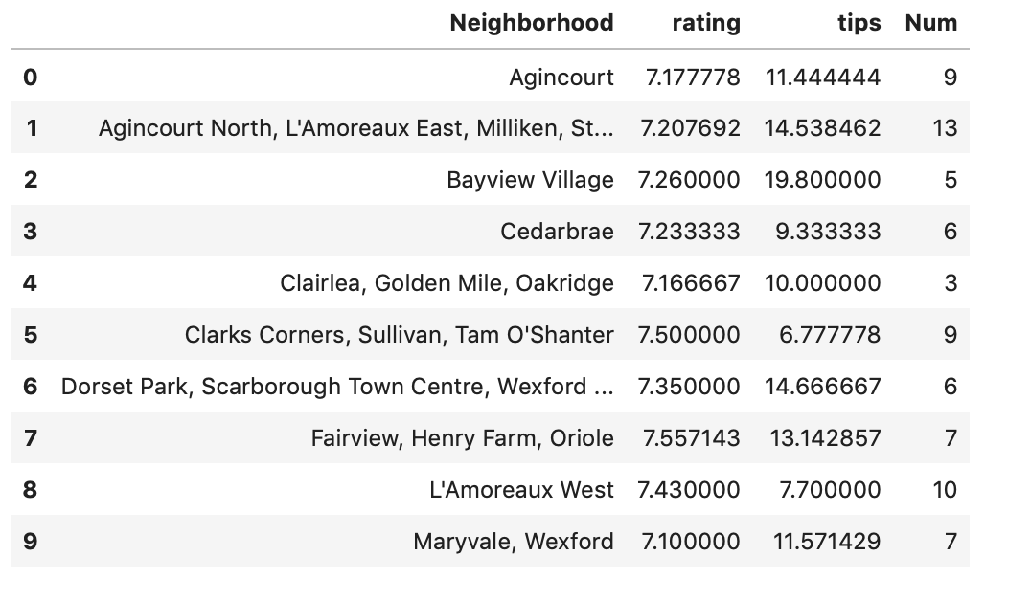
Methodology
Step 5: Getting the number, avg rating and tips of Chinese restaurants for each neighborhood.

Slide 13
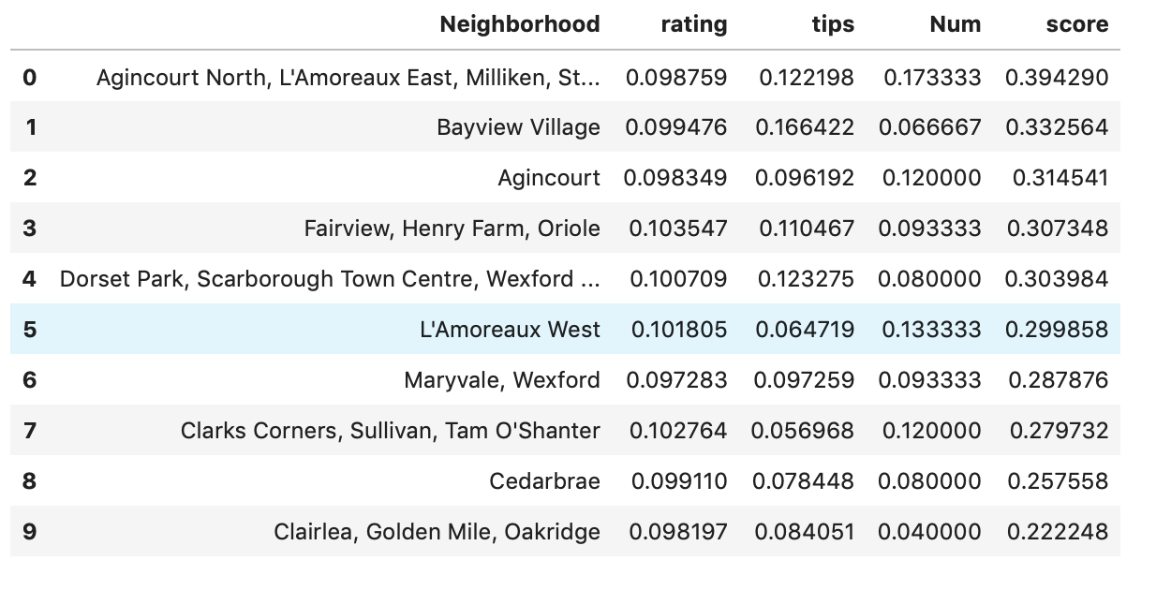
Methodology
Step 6: Standardization and ordering by total score (score = rating + tips + num)

Slide 14
Result
The score of the neighborhood of Agincourt North, L'Amoreaux East, Milliken, Steeles East is the highest.

Slide 15
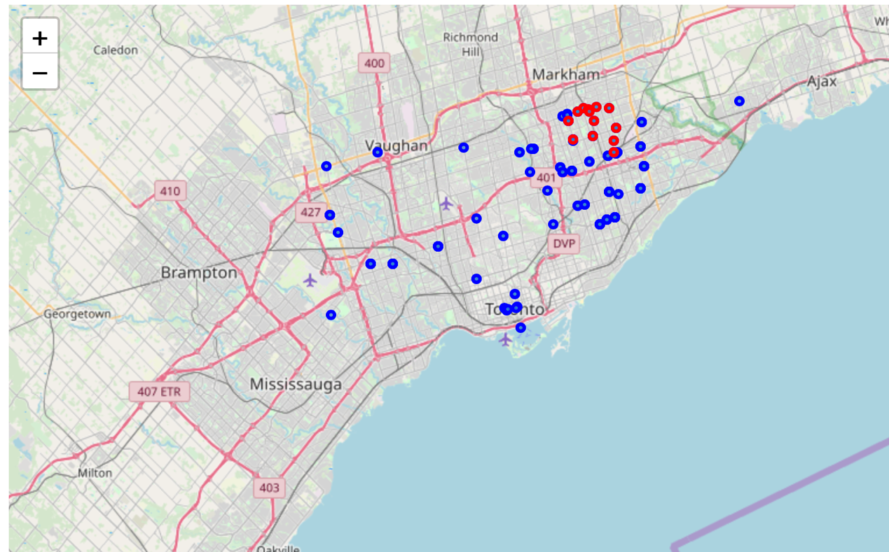
Discussion
The neighborhood of Agincourt North, L'Amoreaux East, Milliken, Steeles East is the best place for opening a new Chinese restaurant.

Slide 16
Conclusion
By using Foursquare data, I can get the number, avg rating and tips of restaurants in each neighborhood.
Based on content-based recommendation system, I can get the best score within neighborhoods.

Slide 17


